Slide 1

INDOOR AND OUTDOOR
INDOOR SPORTS
They require less preparation
They can’t be played in any room
BASKETBALL
VOLLEYBALL
HANDBALL
Futsal
Chess
OUTDOOR SPORTS
They have a larger playing field
Most of them are heavily affected by the wind and other weather conditions
FOOTBALL
TENNIS
SKIING
Cycling, running

Slide 2
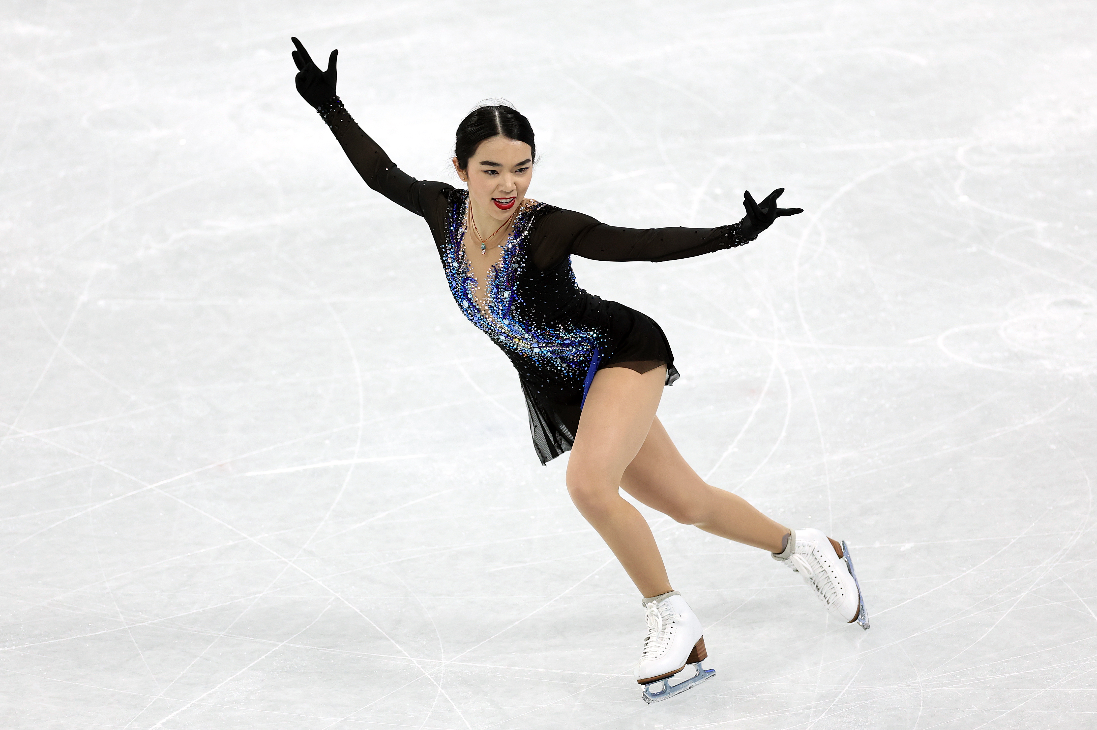
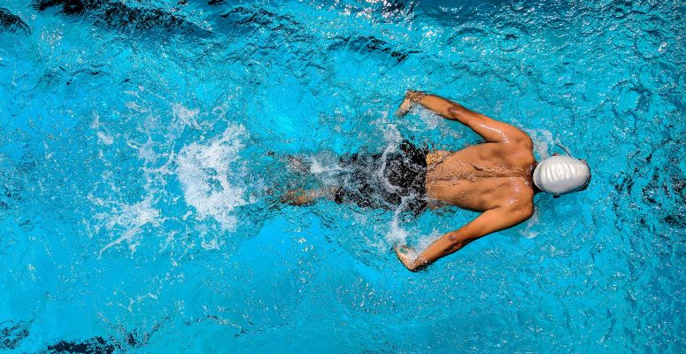
SEASONAL
WINTER SPORTS
Most are only available if the temperature is right
Some of them need a lot more gear and preparation
ICE HOCKEY
SKIING
ICE SKATING
SUMMER SPORTS
Depend less on weather
Depends more on playing field
FOOTBALL
TENNIS
SWIMMING
Beachball

Slide 3
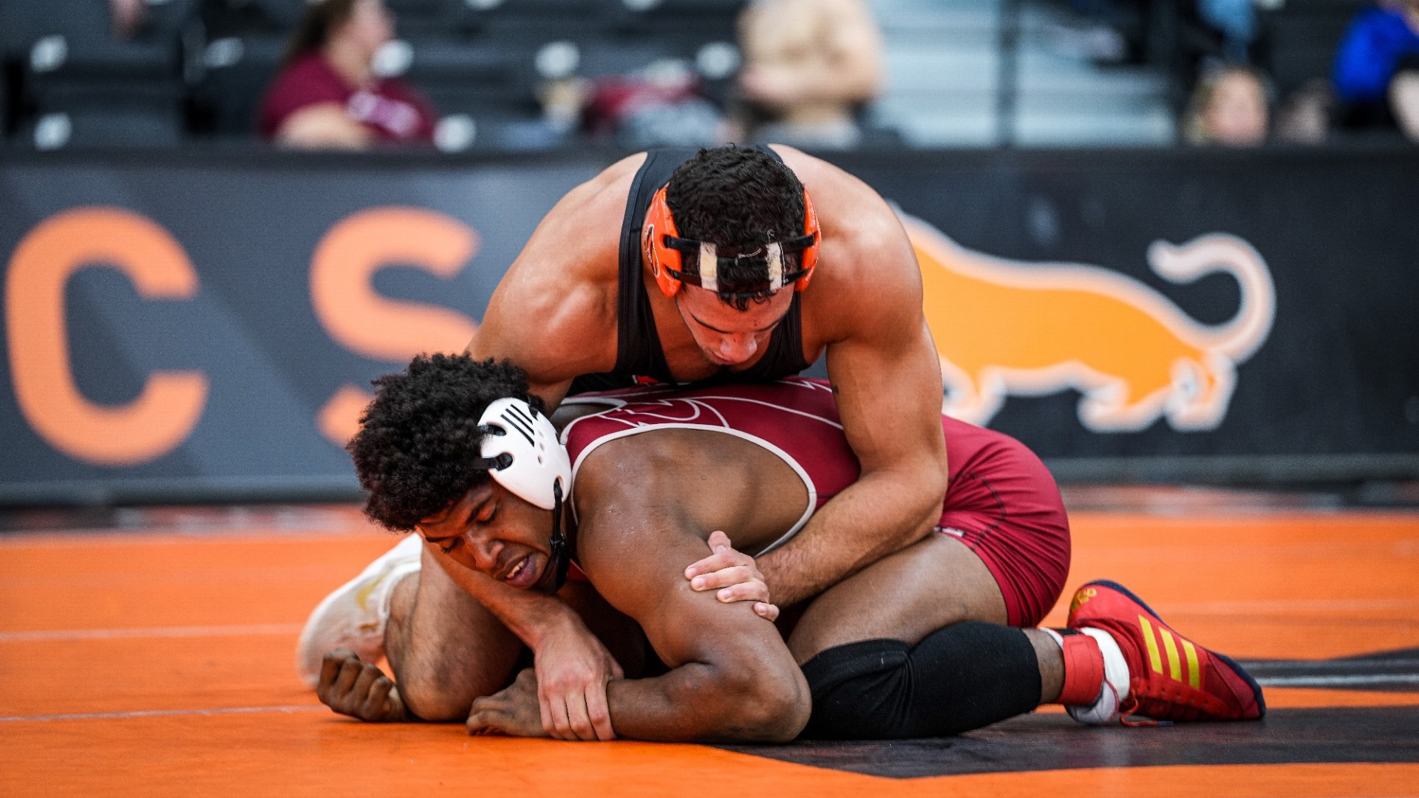
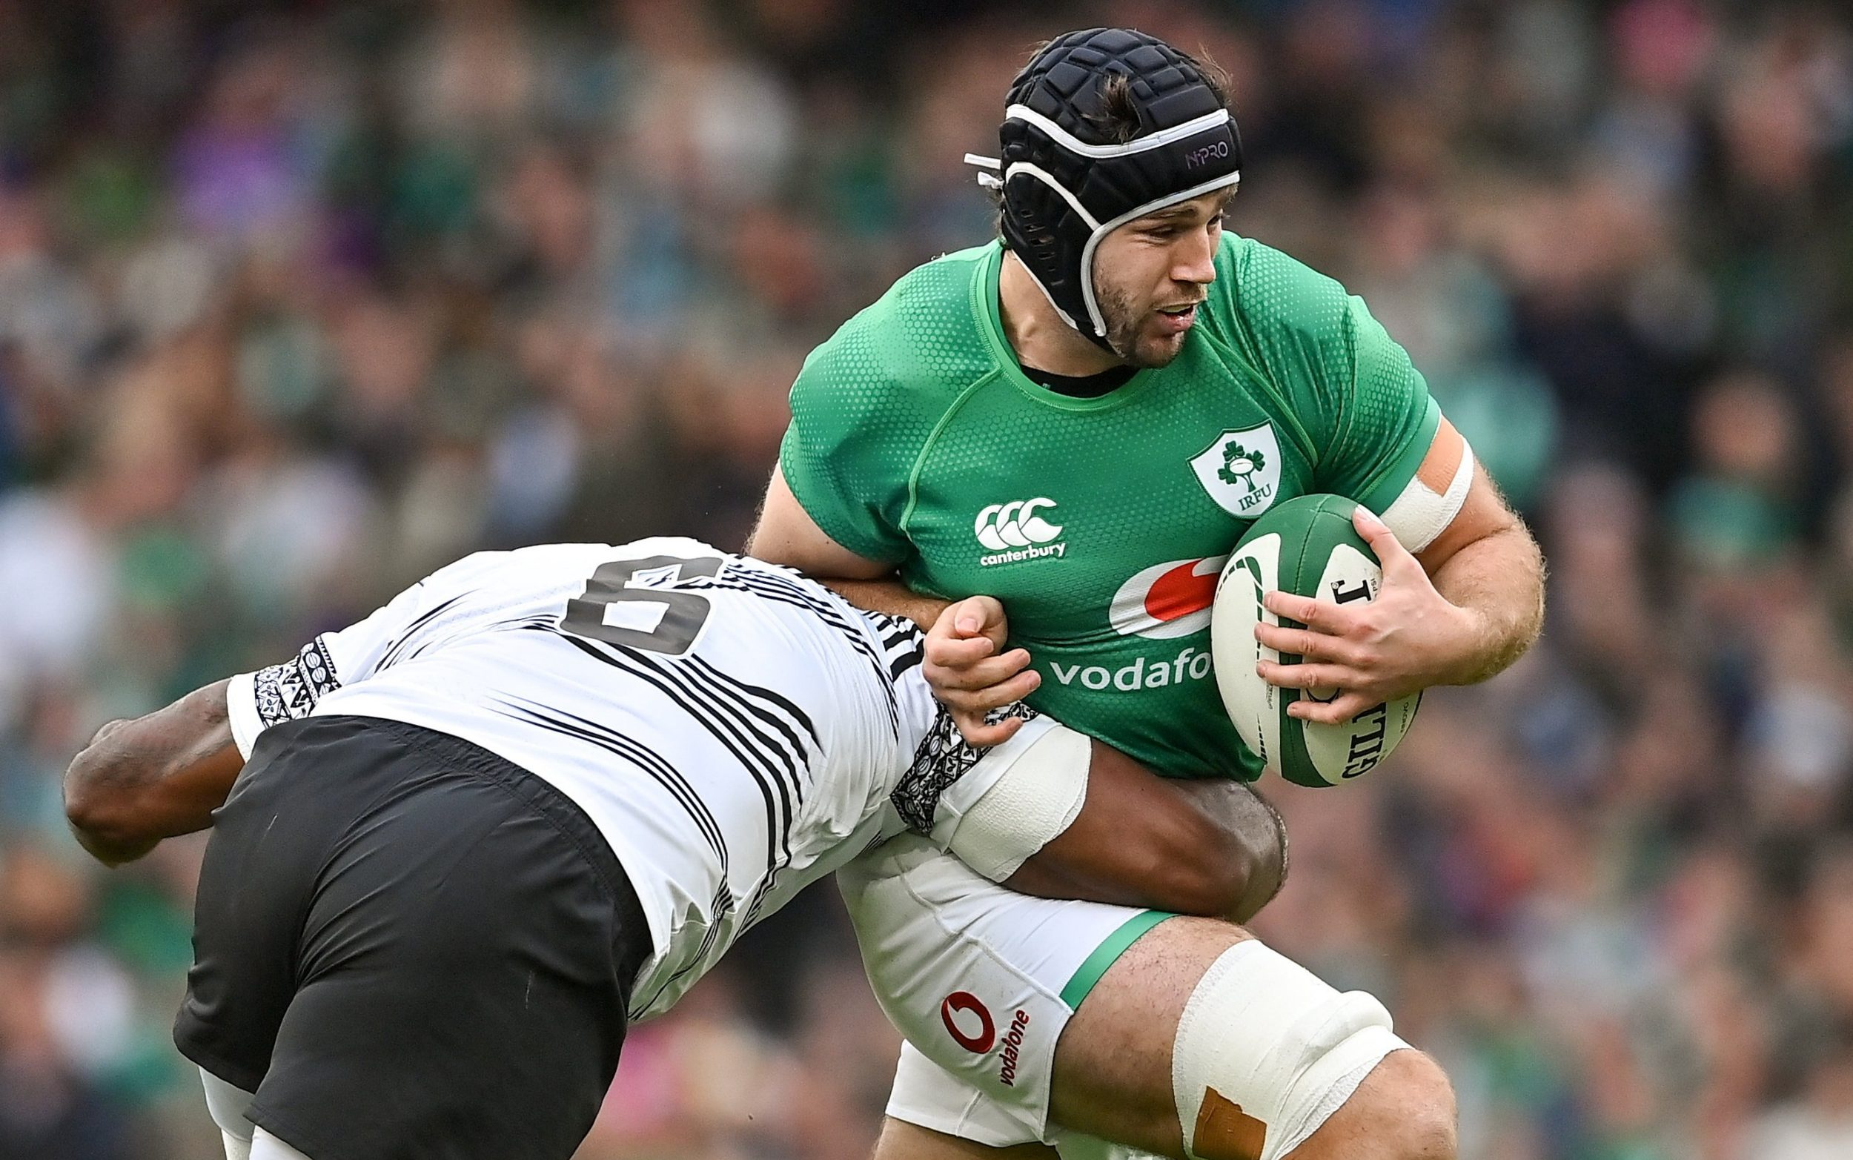
INDIVIDUAL AND TEAM SPORTS
INDIVIDUAL SPORTS
Players have to learn strategies during the game
Players have to know their opponent’s strengths
TABLE-TENNIS
WRESTLING
DARTS
Martial arts
chess
TEAM SPORTS
Teamplay is necessary to win the match
The players can be changed around
VOLLEYBALL
AMERICAN FOOTBALL
RUGBY

Slide 4
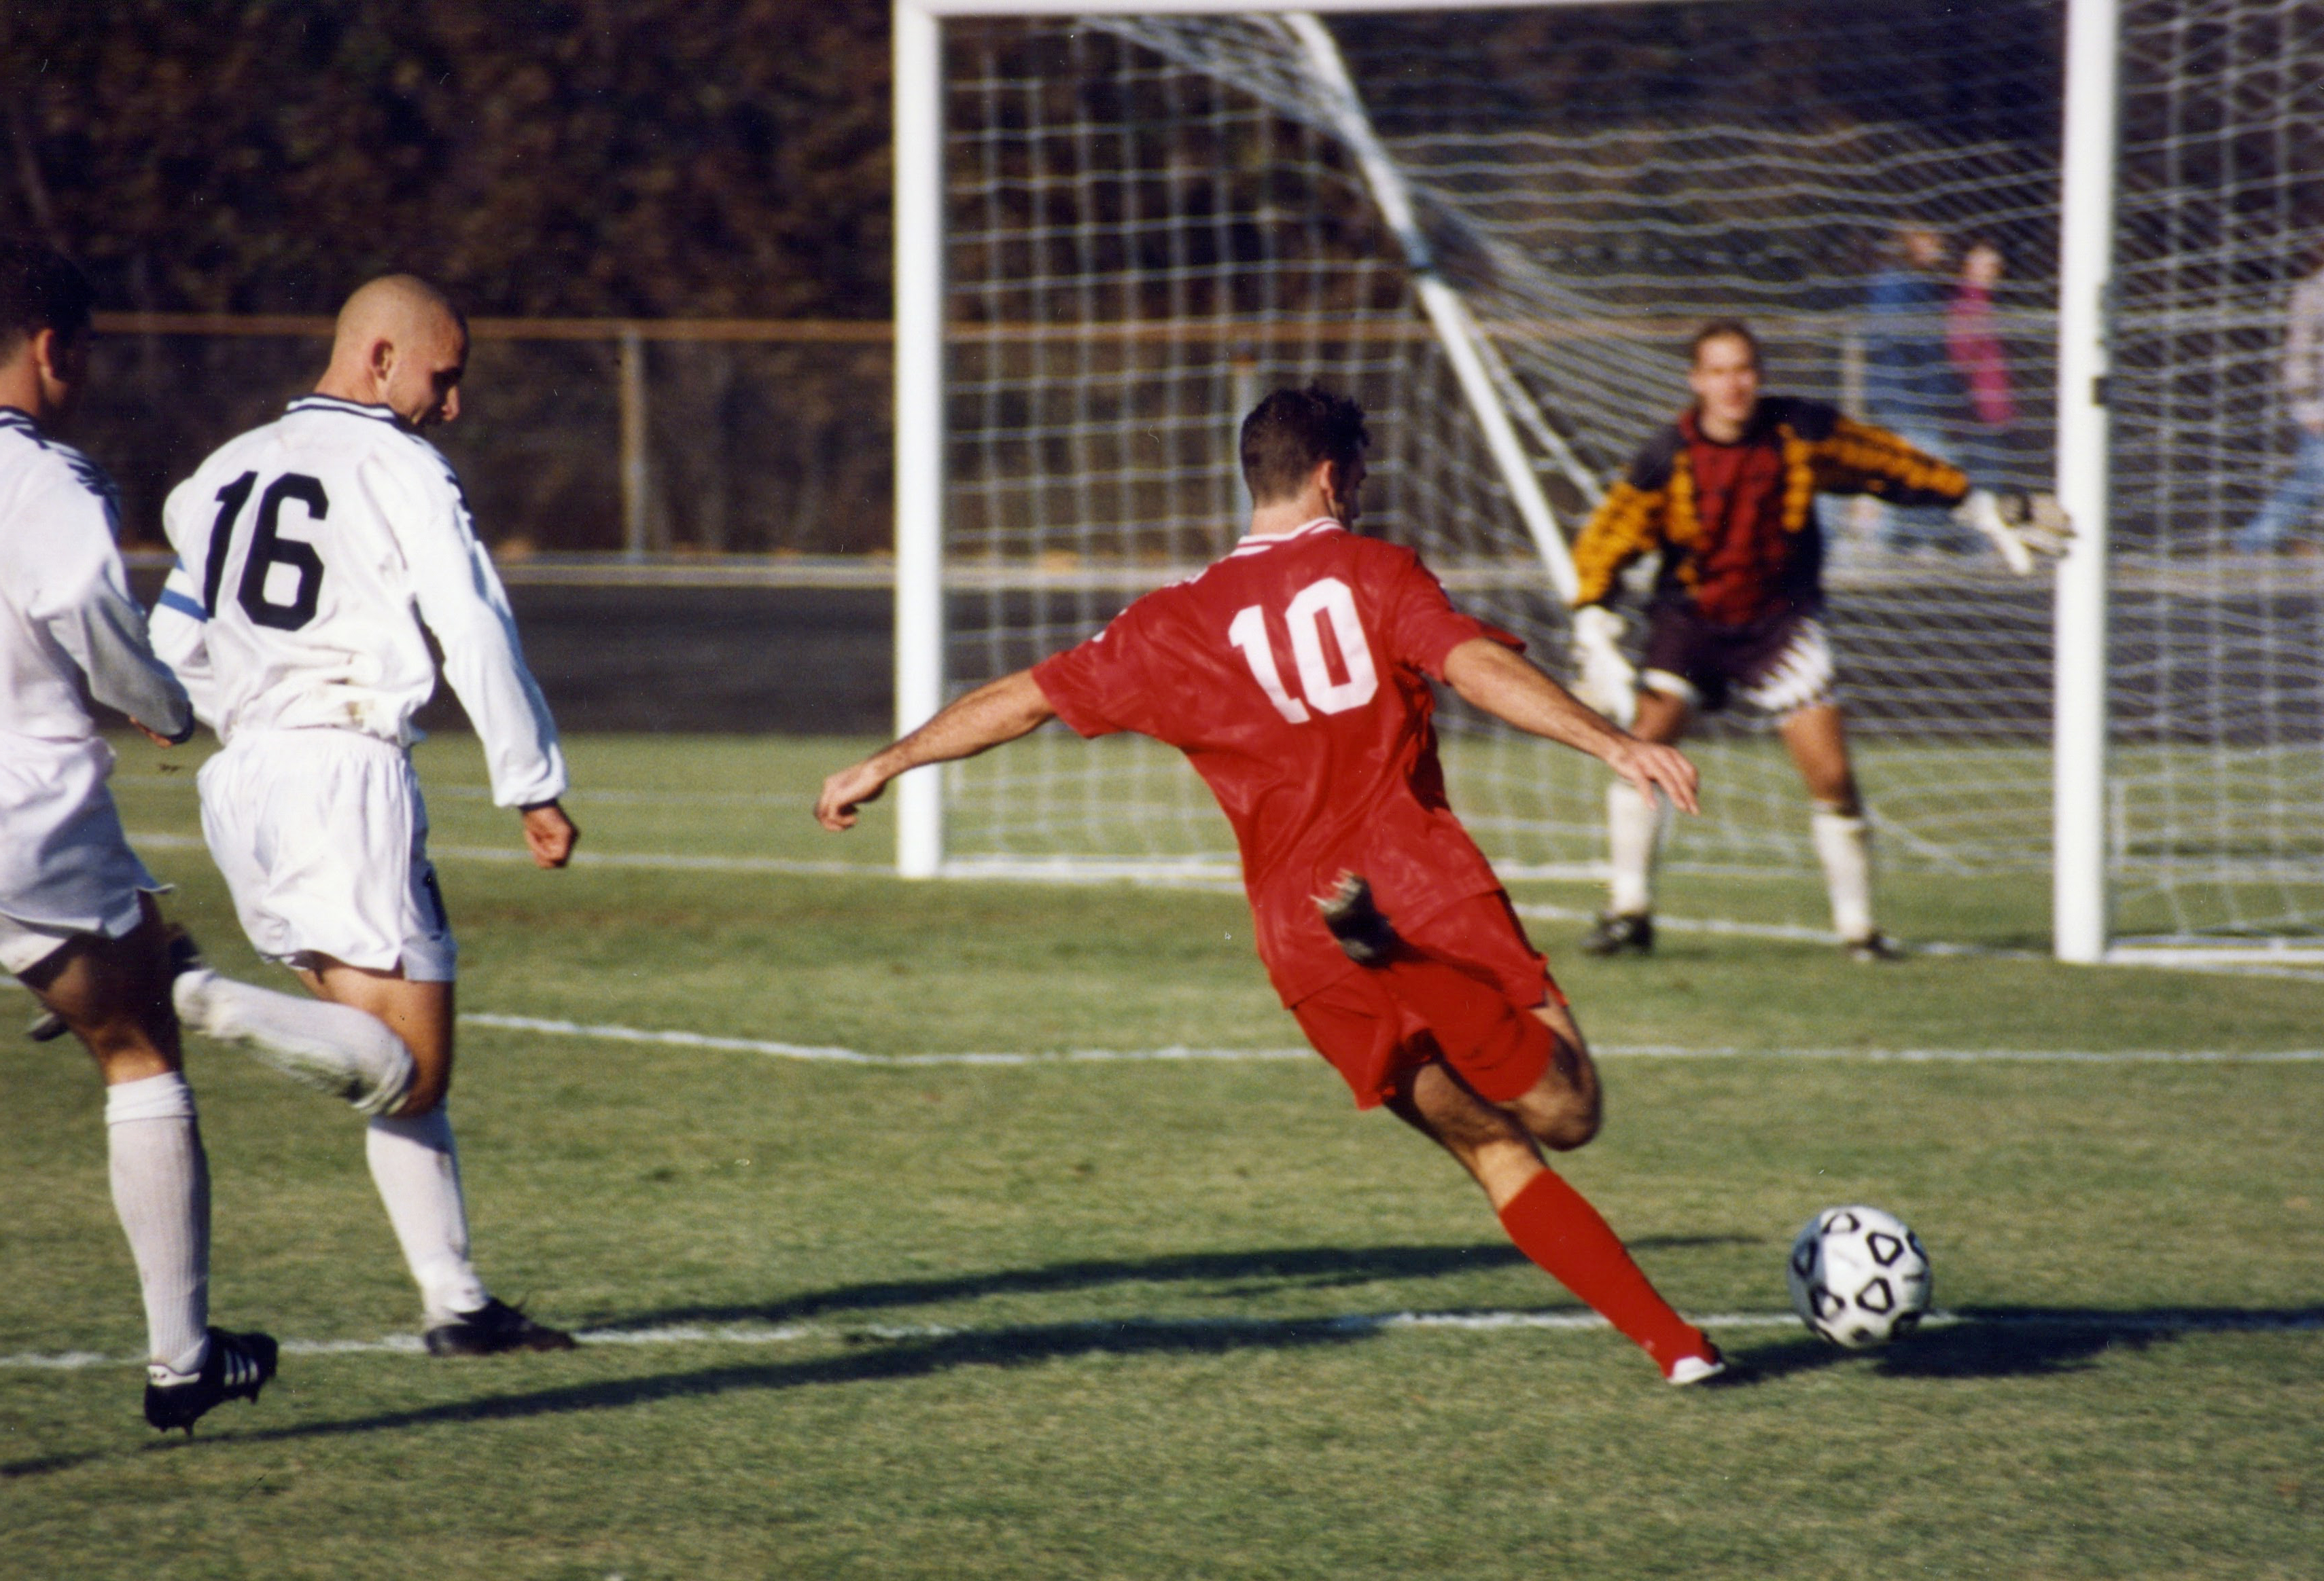
DIFFERENCES BETWEEN TRADITIONAL AND E-SPORTS
TRADITIONAL SPORTS
REQUIRE MORE TRAINING and more physical activity
THEY ARE PLAYED IN REAL PLACES
PLAYERS REPRESENT A COUNTRY

Slide 5

DIFFERENCES BETWEEN TRADITIONAL AND E-SPORTS
E-SPORTS
PLAYERS RARELY REPRESENT A COUNTRY
PARTICIPANTS CAN PLAY FROM COMFORTABLE PLACES
Harmful for your eyes

